Slide 1
CLASSIC CARS SELLING WEBSITEWEBSITE
MENTOR : Ms.S.Sujitha
STUDENT :DHANVANTHRI R
REG : 99220040042

Slide 2
ABSTRACT
This project is about creating a simple website where people can sell classic cars. We use HTML, CSS, and JavaScript to make it easy to use, look good, and work on phones and computers.
The website lets sellers show off their cars with pictures and details, and buyers can find cars by searching. Our goal is to make buying and selling classic cars easy and fun for everyone.

Slide 3
INTRODUCTION
Our project is about creating a website dedicated to selling classic cars, using easy-to-understandweb tools like HTML, CSS, and JavaScript. We’re focused on making a place where people whowant to sell their classic cars can connect with those who want to buy them. The website will besimple to use, letting sellers list their cars with photos and details, and buyers to easily find andadmire these vintage beauties. Designed to work smoothly on phones, tablets, and computers,our site also includes a straightforward way for buyers to contact sellers directly.

Slide 4
OBJECTIVE
The objective of this project is to create a simple and user-friendly website for selling classic cars, using HTML, CSS, and JavaScript. It aims to connect sellers with buyers through easy-to-use features like car listings, search options, and direct contact forms, all within a responsive design for accessibility on any device.

Slide 5
WORKFLOW CLASSIC CARS SELLING WEBSITE
PLAN
CONTENT CREATION
HTML STRUCTURE
TESTING AND DEPLOYMENT
INTERACTIVE ELEMENTS(JS) ,CSS STYLING

Slide 6
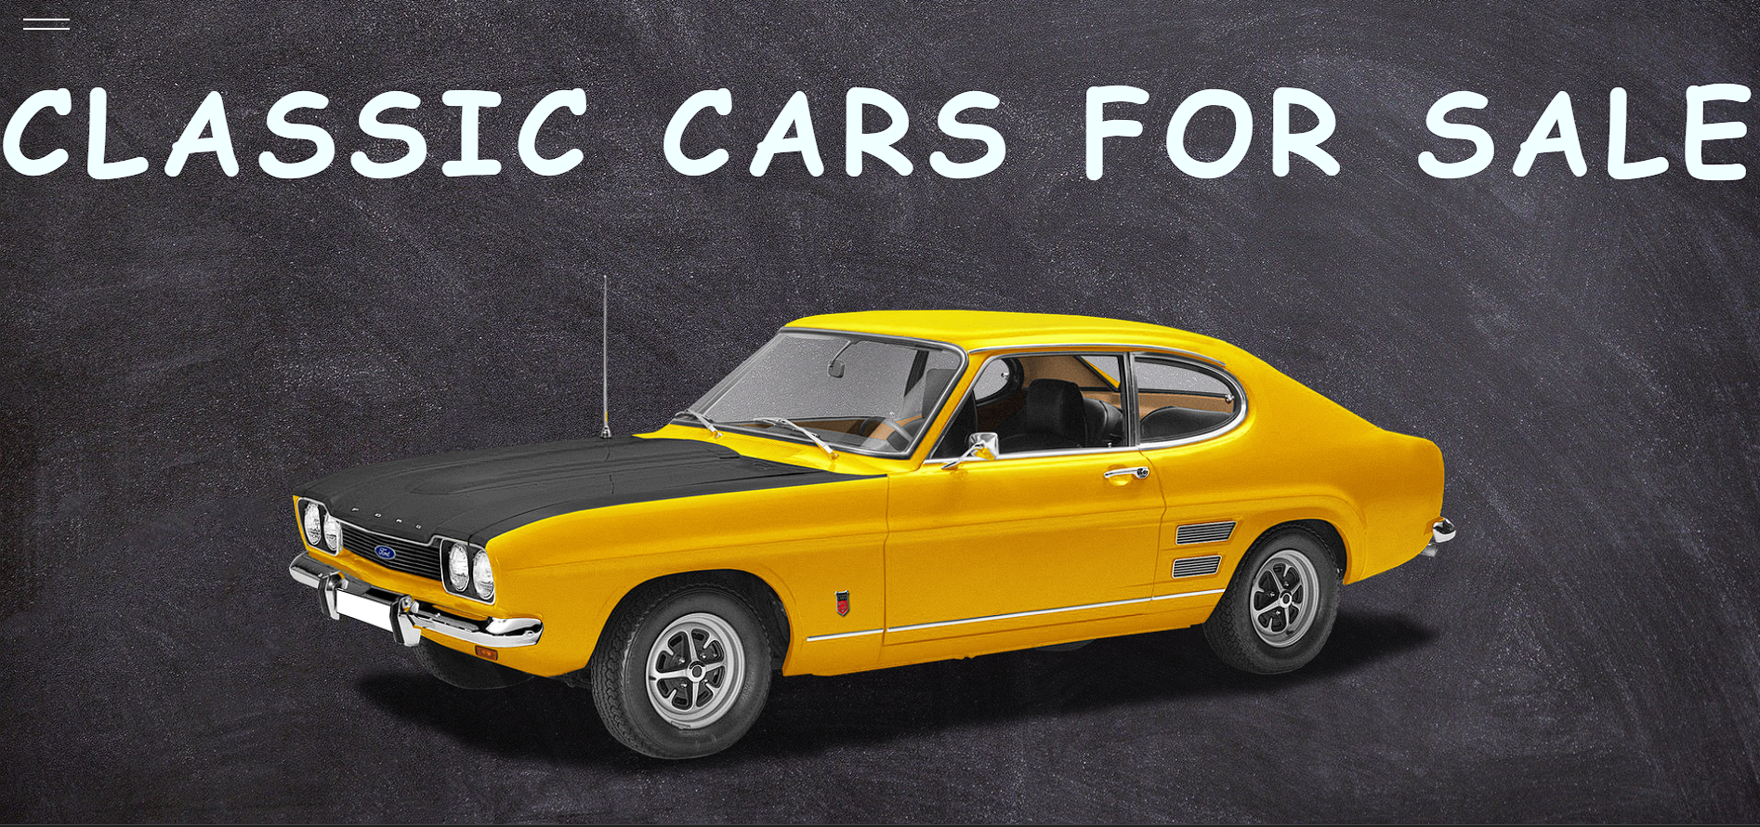
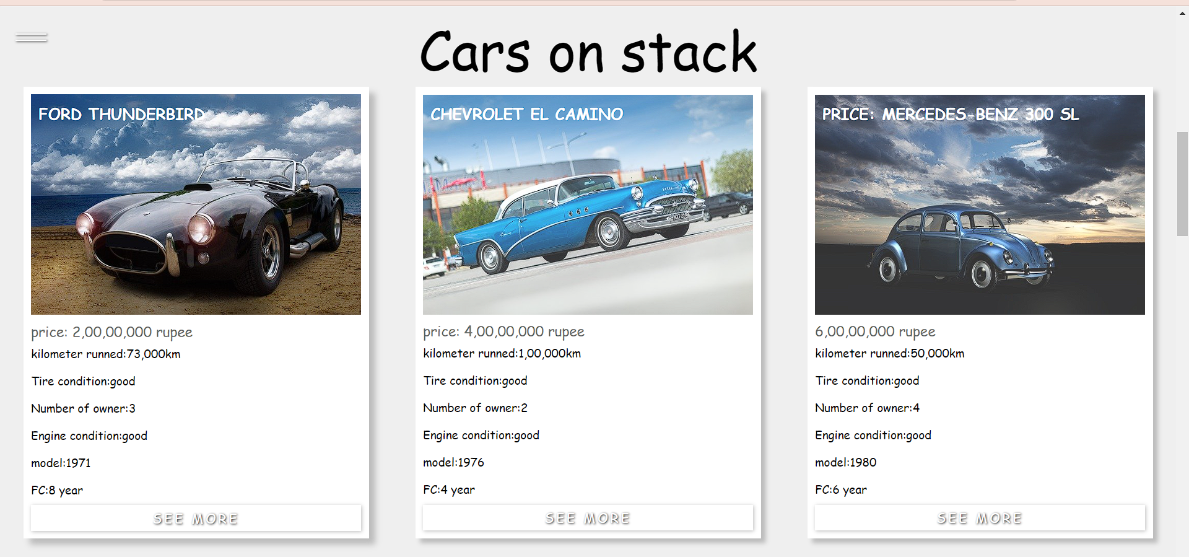
OUTPUT

Slide 7
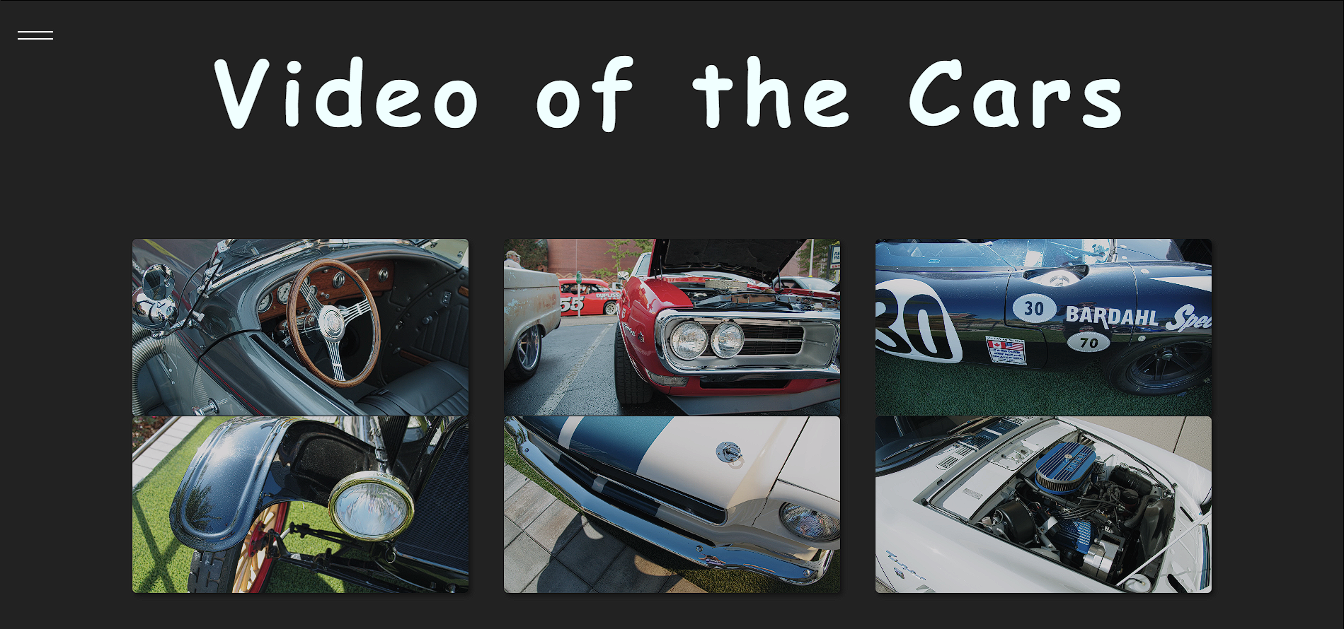
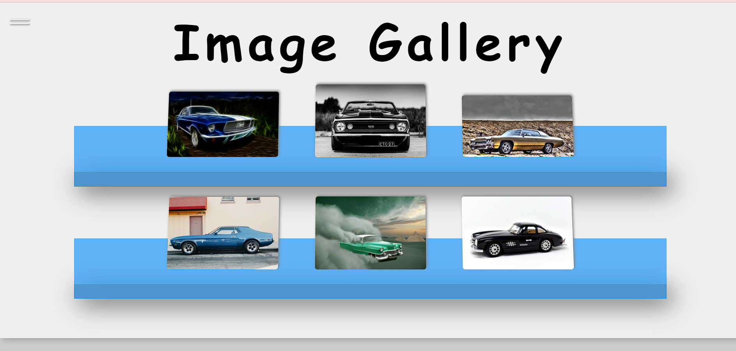
OUTPUT

Slide 8
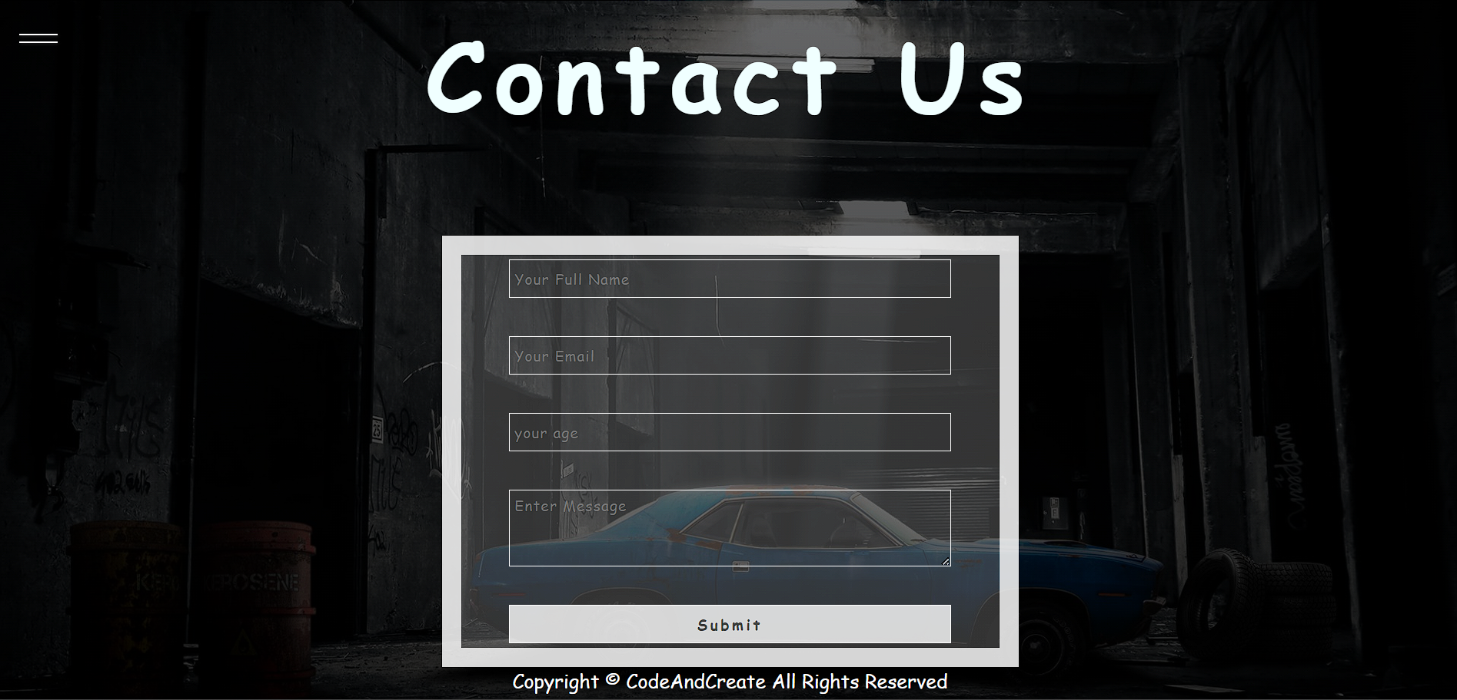
OUTPUT

Slide 9
CONCLUSION
In wrapping up, our project to build a classic car selling website has achieved its goal of creating an easy and fun place for people to sell and buy classic cars online. Using simple web tools like HTML, CSS, and JavaScript, we made a site that looks good and works well, no matter if you're on a phone or a computer. We also set up a space where car fans can connect and share their love for classic cars. This project shows how a good idea can come to life with technology and teamwork, making it simpler for everyone to enjoy the beauty and history of classic cars.

